Slide 1
CAR Calibration Session “Good” CAR, “Bad” CAR Review
Team A: J. Y. Lee, WeiBeng Leong, Simy Li, Thomas Kestner
May 7, 2012

Slide 2
Agenda
Sample 1 CAR Needing Improvement
CAR 1139850 Thomas
2. Sample 2 CAR Needing Improvement
CAR 11399377 Simy
3. Sample 3 Good CAR No. 113910033 JY
Sample 4 Good CAR
CAR 11399204 WeiBeng

Slide 3
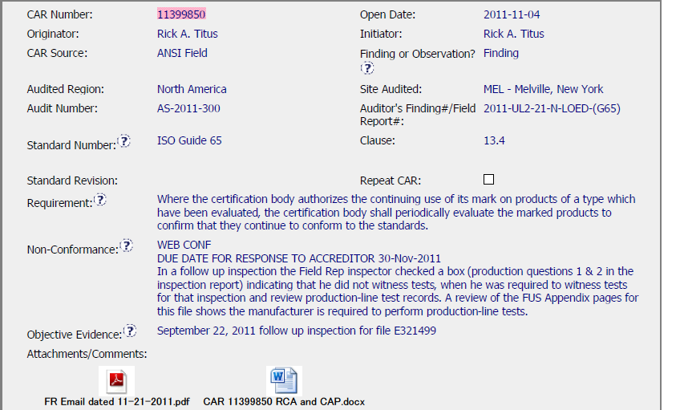
Sample 1 - CAR Needing Improvement CAR No. 11399850
Main Copy Arial 20 pt. This study was conducted in two phases: a qualitative exploratory phase followed by a quantitative survey. The first phase consisted of a series of focus groups with U.S. consumers.
Indent 1 Arial 18 pt. + 10 pts before paragraph
The focus groups were conducted across a broad range of life-stage segments and key product purchaser segments to ensure that the complete range of consumers’ safety attitudes, motivations and behaviors were identified.
– Indent 2 Arial 16 pt. + 6pts before paragraph – Young singles, adults age 21-34, living outside their parents’ home – Parents with younger children (< 6), and no children >6 years of age – Parents with older children (divided evenly between 6-12 and 13-17) – Adults 25 – 54 without children – Empty Nesters, adults age 45 – 64

Slide 4
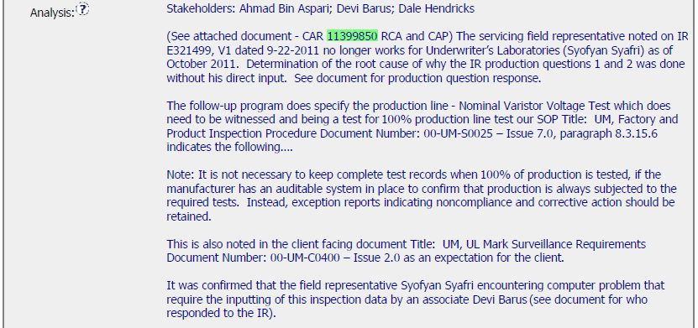
Sample 1 - CAR Needing Improvement CAR No. 11399850

Slide 5
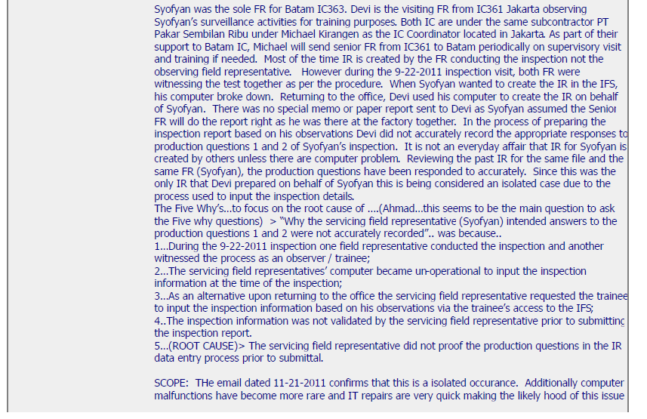
Sample 1 - CAR Needing Improvement CAR No. 11399850

Slide 6
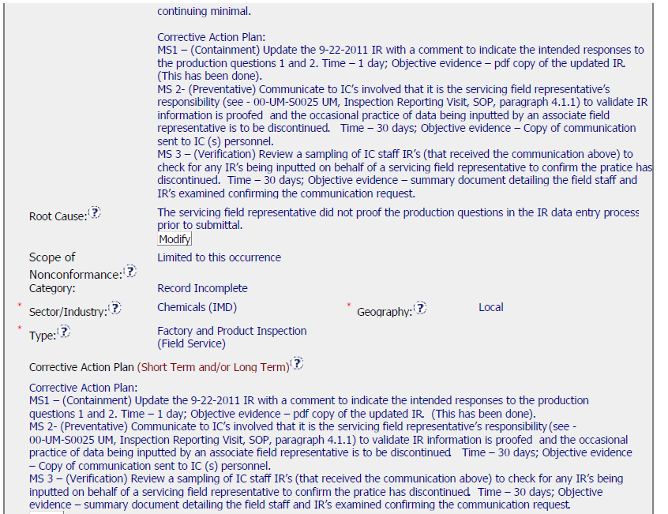
Sample 1 - CAR Needing Improvement CAR No. 11399850

Slide 7
Sample 1 - CAR Needing Improvement CAR No. 11399850 Discussion
The analysis is good.
However the root cause, which states that the FR did not proof the report before it was submitted, is not sufficient.
Lack of inspection, in my opinion, is not the root cause.
The question that needs to be answered, is why Devi (whether he be a trainee or senior FR) was not able to complete the report with the correct response.
The practice of writing reports on behalf of other FRs was stopped, but Devi’s own reports may be at fault, even today.

Slide 8
Sample 1 - CAR Needing Improvement CAR No. 11399850 Discussion
The analysis is good.
However the root cause, which states that the FR did not proof the report before it was submitted, is not sufficient.
Lack of inspection, in my opinion, is not the root cause.
The question that needs to be answered, is why Devi (whether he be a trainee or senior FR) was not able to complete the report with the correct response.
The practice of writing reports on behalf of other FRs was stopped, but Devi’s own reports may be at fault, even today.

Slide 9
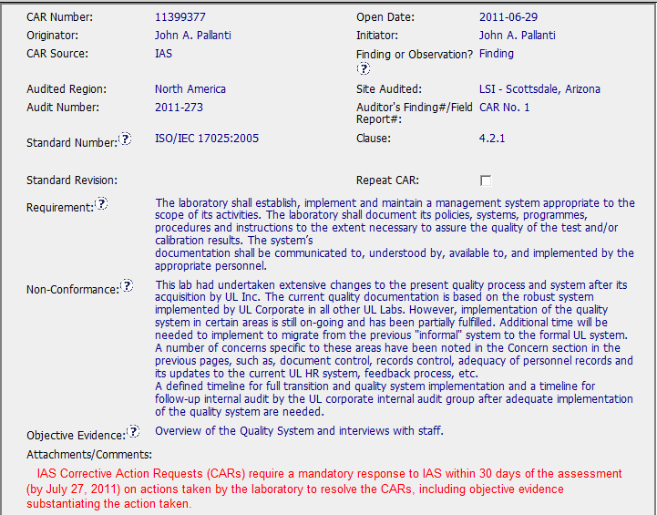
Sample 2 - CAR Needing Improvement CAR No. 11399377
Non-conformance is vague
1
1
Objective evidence is not clear and specific

Slide 10
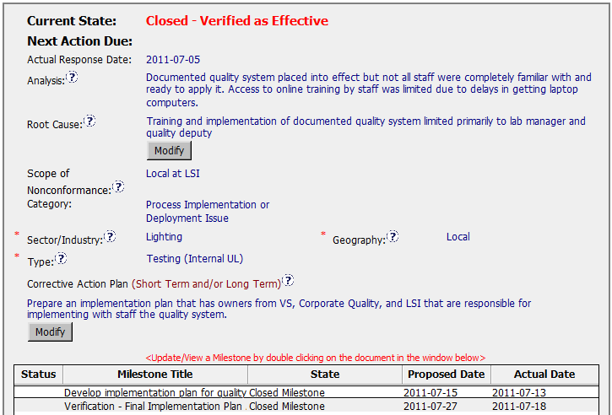
Sample 2 - CAR Needing Improvement CAR No. 11399377
2a
Should ask “Why”? Due to no training, ineffective implementation ..?
2b
Is online training the only means to train up the staff? Any classroom / practical training not relying on laptop can be arranged earlier?
2a
2b
Analysis could not draw to the “Root Cause” statement.
(Training and implementation not included all staff & not for the whole company.)
3
Best to mention which area(s) are not complied as mentioned in Non-compliance section that implementation of the QMS partially complied.
4
5
5
Containment action and verification haven’t been specified in the CAP.
IQA can be one of the verification methods.
6
6
Get Final implementation approved – not a verification.

Slide 11
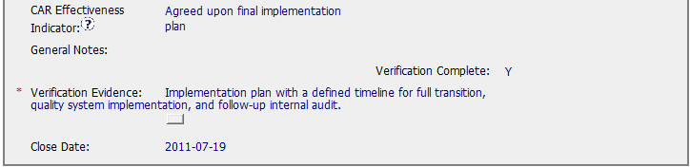
Sample 2 - CAR Needing Improvement CAR No. 11399377
7
7
Don’t see where is the internal audit done? No
evidence it was done or timeline that it will be done.

Slide 12
Sample 2 - CAR Needing Improvement CAR No. 11399377 Discussion
Non-conformance : Didn’t clearly describe the non-complied area(s), just mentioned QMS wasn’t implemented. Need to be more specific so that the CAR owner what to focus.
2a Analysis : Should ask “Why”? Due to no training, ineffective implementation ..?
2b. Analysis : Is online training the only means to train up the staff? Any classroom / practical training not relying on laptop can be arranged earlier?
Root Cause Analysis : Analysis could not draw to the “Root Cause” statement. (Training and implementation didn’t include all staff and not for the whole company.)
Scope of Non-conformance : Best to mention which area(s) are not complied as mentioned in Non-compliance section that implementation of the quality system has been partially complied.
Corrective Action Plan : Containment action and verification haven’t been specified in the CAP. IQA can be one of the verification methods.
Verification Milestone : Get Final implementation approved – not a verification.
7. Verification Evidence : Don’t see where is the internal audit done? No
evidence it was done or timeline that it will be done.

Slide 13
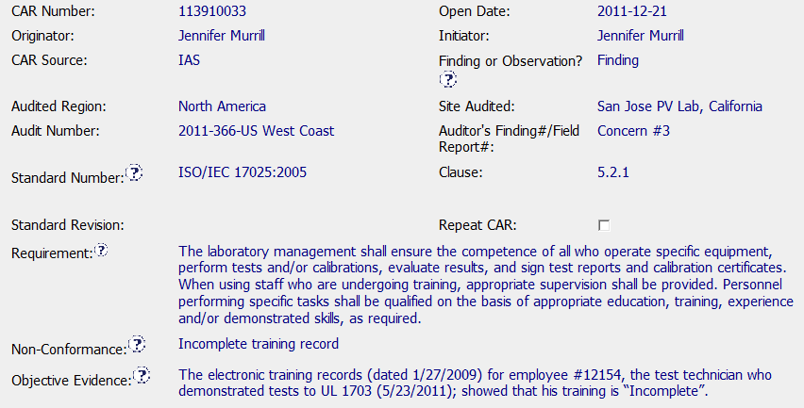
Sample 3 Good CAR No. 113910033

Slide 14
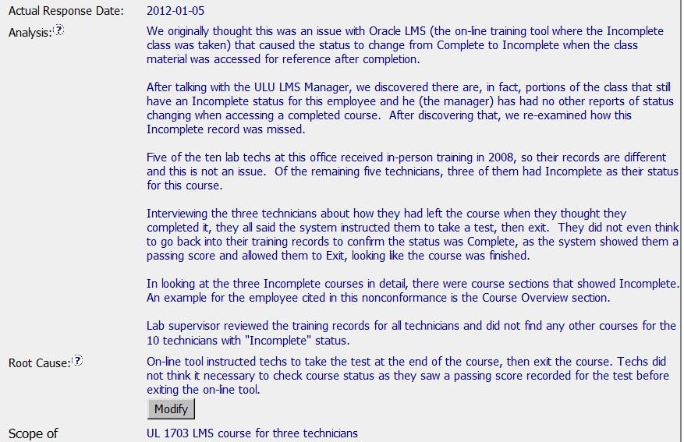
Sample 3 Good CAR No. 113910033

Slide 15
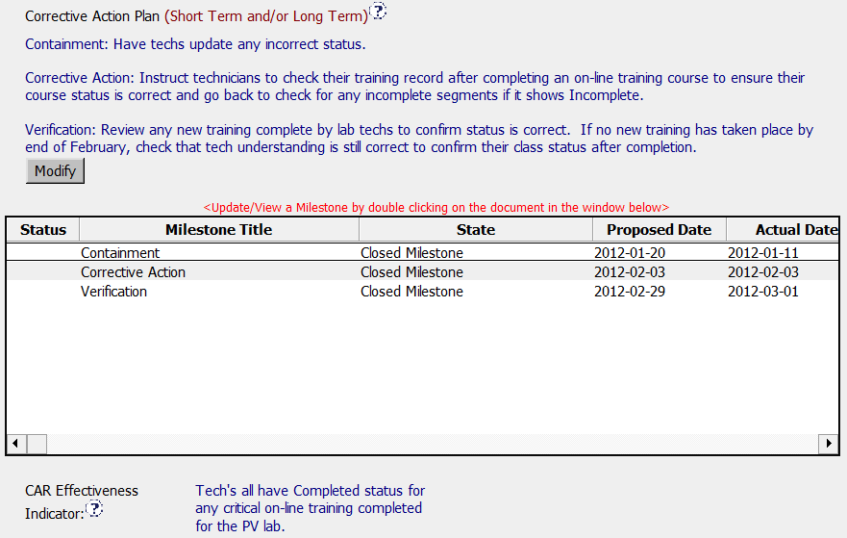
Sample 3 Good CAR No. 113910033

Slide 16
Sample 3 Good CAR No. 113910033 Discussion
Very clear & logical analysis. Staff can easily understand whole story in a very short time. (Compare to many other long analysis CARs, staff may need to read many times and still not clear what happened.)
Clear root cause that is concluded based on clear analysis

Slide 17
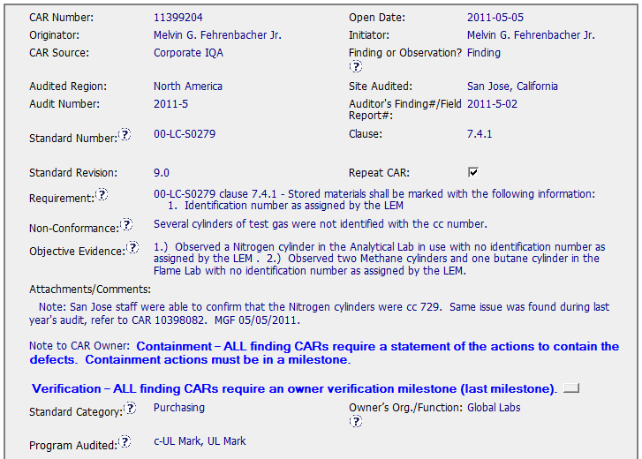
Sample 4 - Good CAR CAR No. 11399204

Slide 18
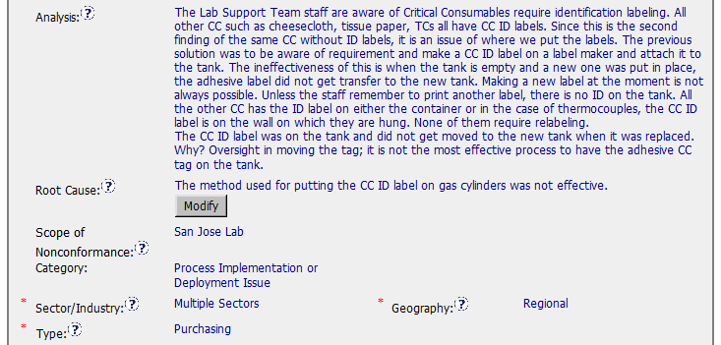
Sample 4 - Good CAR CAR No. 11399204

Slide 19
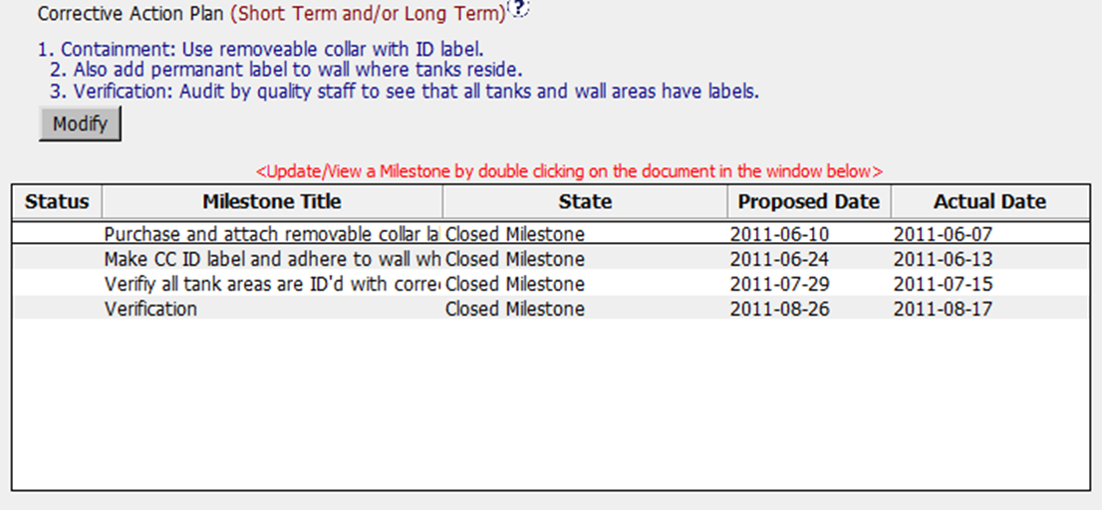
Sample 4 - Good CAR CAR No. 11399204

Slide 20
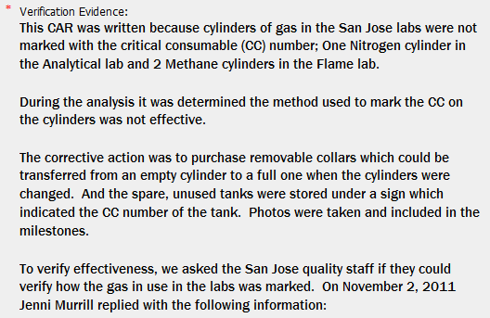
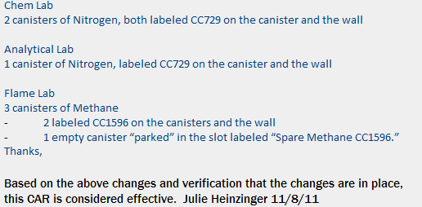
Sample 4 - Good CAR CAR No. 11399204

Slide 21
Sample 4 - Good CAR CAR No. 11399204 Discussion
The Analysis is clear and complete, leading to the root cause for missing Critical Consumables identification labeling.
The root cause is reasonably arrived at based on the analysis. The method used for putting the CC ID label on gas cylinders is correctly concluded as being not effective.
Scope of the nonconformance tells us that the problem is isolated to San Jose Lab.
Corrective Actions fixed the defects in the objective evidence by labeling the CC with missing ID; addressed the root cause by having removable collar and permanent label ID.
Milestones have a containment, verification and other milestones as described in CA
The effectiveness of the CA were verified by quality staff checking the CC ID three months after the CAR closure.

Slide 22
THANK YOU.

Slide 23
Case Study
Team: John Pallanti, Chris Nicastro,
Gary Gardell, Kathy Lindstrom

Slide 24
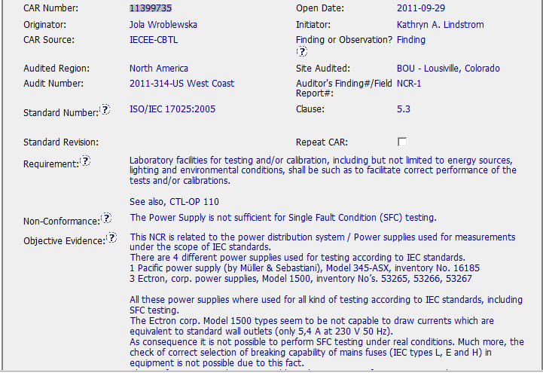
Good CAR – Sample 1
CAR Number: 11399735

Slide 25
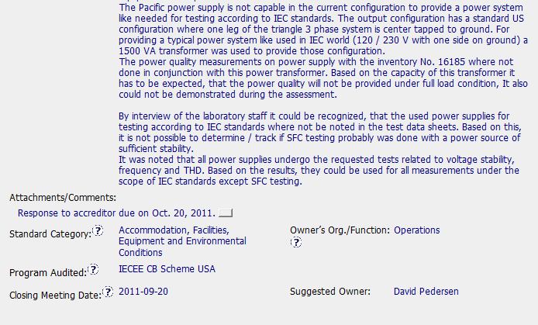
Good CAR Sample 1
CAR Number 11399735

Slide 26
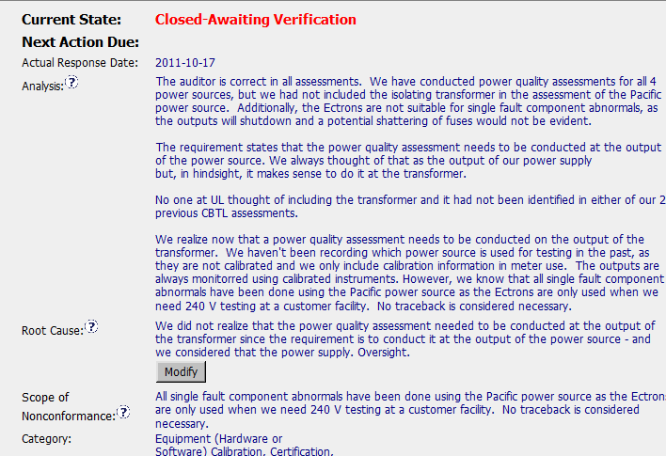
Good CAR – Sample 1
CAR Number: 11399735

Slide 27
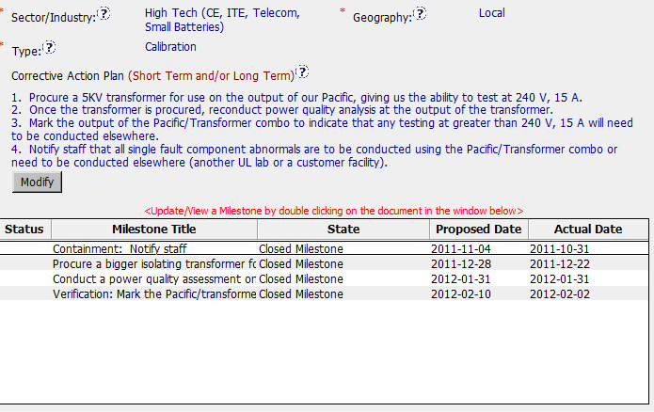
Good CAR – Sample 1
CAR Number: 11399735

Slide 28
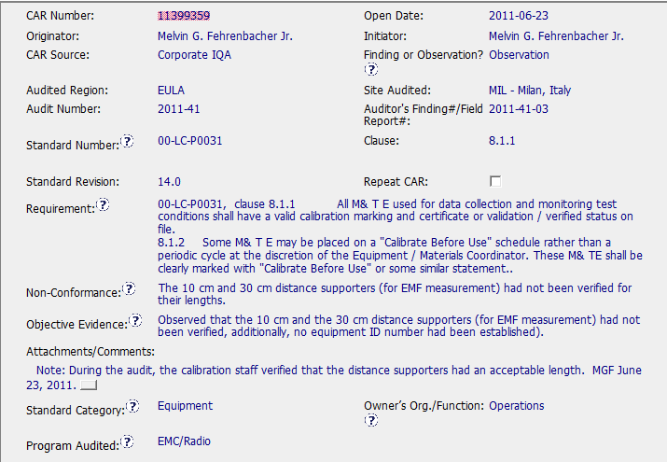
Good CAR – Sample 2
CAR Number: 11399359

Slide 29
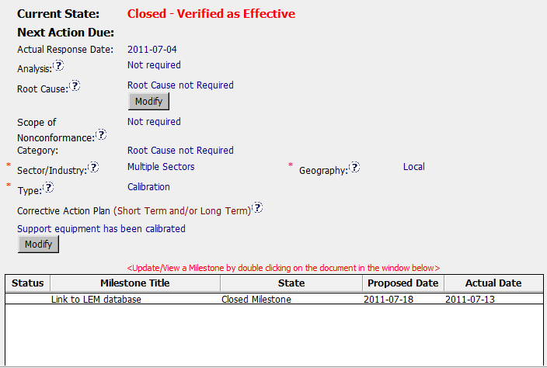
Good CAR – Sample 2
CAR Number: 11399359

Slide 30
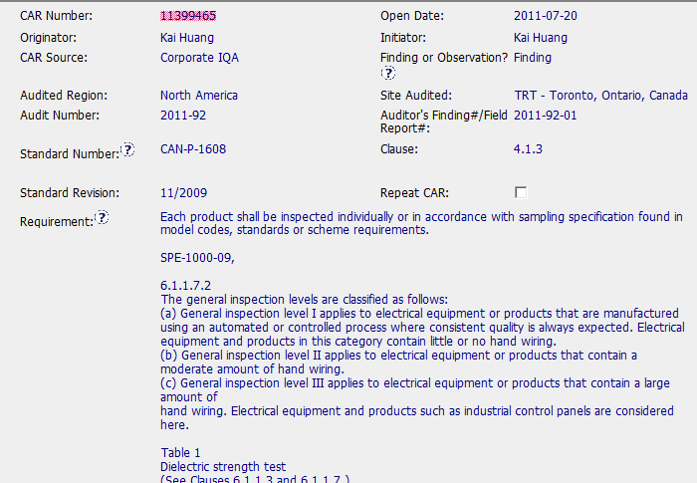
CAR Needing Improvement - Sample 1
CAR Number: 11399465

Slide 31
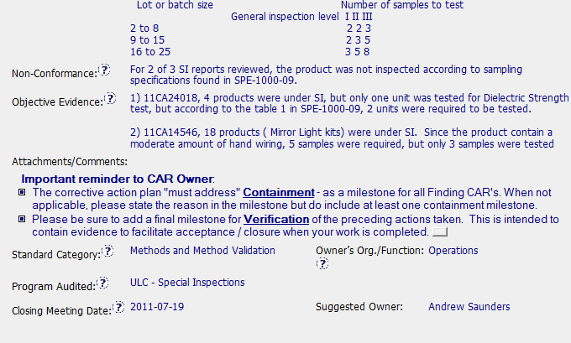
CAR Needing Improvement - Sample 1
CAR Number: 11399465

Slide 32
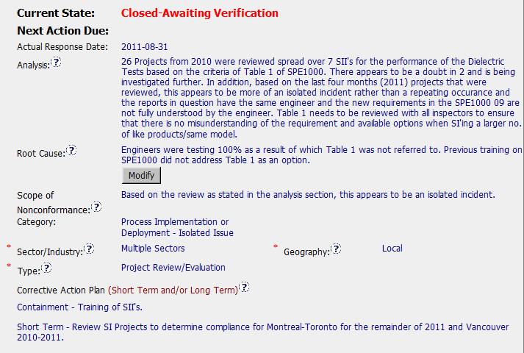
CAR Needing Improvement - Sample 1
CAR Number: 11399465

Slide 33
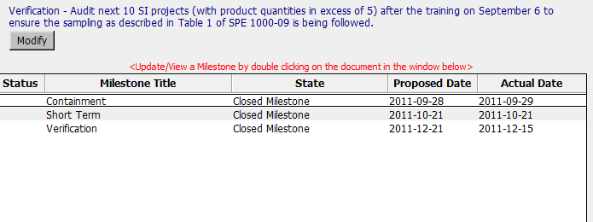
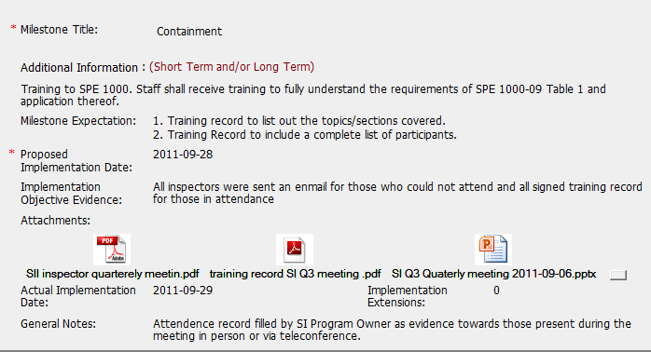
CAR Needing Improvement - Sample 1
CAR Number: 11399465

Slide 34
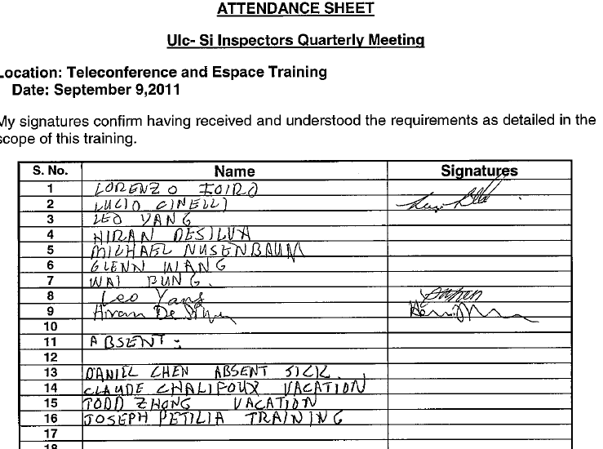
CAR Needing Improvement - Sample 1
CAR Number: 11399465

Slide 35
CAR Needing Improvement - Sample 1
CAR Number: 11399465
Concerns:
The analysis says that other projects were reviewed and this is an isolated incident – those project numbers are not listed and should be. Analysis does not seem complete and does not flow into the root cause – how did they get from the analysis to the root cause? Root cause is unclear – why did staff not know about table 1? Training is given as the next why, but are there any other reasons?
In containment milestone, they have a training record (2nd attachment) that shows 11 names, but only 3 people signed it. So 8 people didn’t get the training. They could have done an additional step such as an e-mail with confirmation, etc. There’s a note that says people were on the phone, but the training sheet isn’t clear since there’s nothing in the signature space.
Good note: Verification evidence is very complete with project numbers, etc.

Slide 36
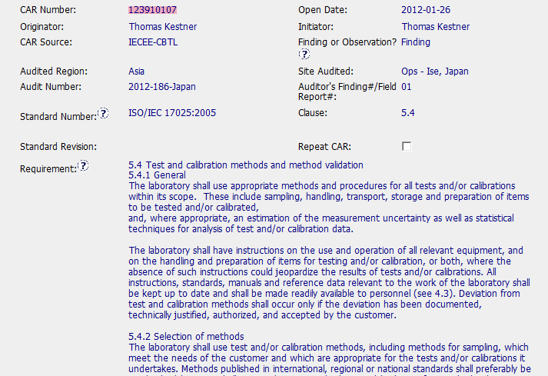
CAR Needing Improvement - Sample 2
CAR Number: 11399465

Slide 37
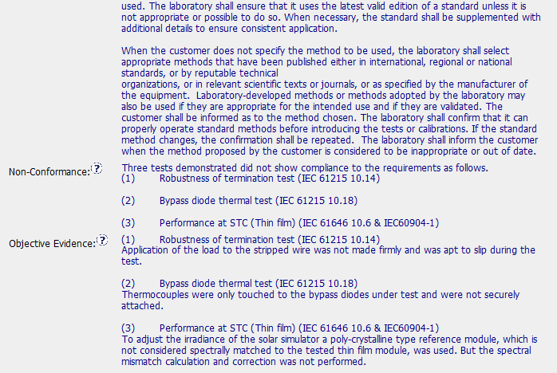
CAR Needing Improvement - Sample 2
CAR Number: 123910107
1

Slide 38
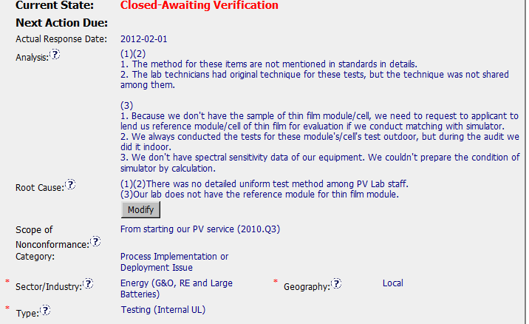
CAR Needing Improvement - Sample 2
CAR Number: 123910107
1

Slide 39
CAR Needing Improvement - Sample 2
CAR Number: 123910107
1

Slide 40
CAR Needing Improvement - Sample 2
CAR Number: 123910107
Concerns:
1. The Analysis for Items (1) and (2) doesn’t go deep enough to get to the true root cause. They didn’t ask: “Why did the technicians have original techniques for these tests?”; “Why was there not a uniform lab test method among the technicians?”; “Why didn’t they share techniques among them?”; “Are there other areas where there is not a uniform lab test method among the technicians?”. They developed procedures to fix the issues identified, but didn’t address if there are other areas where different techniques are being used and not shared.
The Analysis for Item (3) also doesn’t go deep enough and ask more “Whys”. The analysis appears to be a series of disjointed statements.
2. The Root Cause for Item (3) comes from the starting point of the Analysis and ignores the rest of it.

Slide 41
CAR Needing Improvement - Sample 2
CAR Number: 123910107
Concerns:
3. The Corrective Action Plan for Item (3) includes training, but the need for training doesn’t flow from the Root Cause.
4. Objective evidence for milestone 2 has 3 SOPs on how to conduct the test, but they do not show any evidence of document control.
5. Objective evidence for Verification was pictures of the test being conducted correctly and a datasheet. However, the tests were all conducted by the same technician. Since the analysis said that different techs had different methods, we would have expected to see more than just one name performing the tests.

Slide 42
2012 Q2 CAR Administration Calibration Meeting
Team B – Good CAR / Bad CAR Review
Rebecca Navarrete
Dale Piechocki
Bill Costello

Slide 43
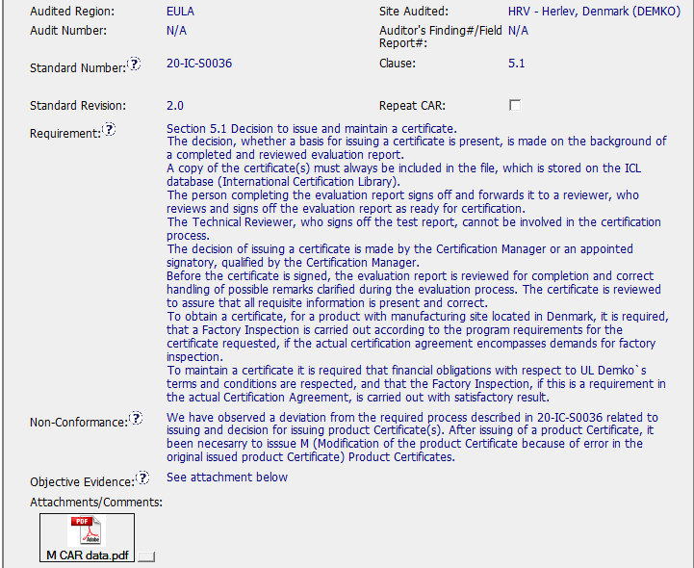


Good CAR (11398960)
Non-conformance relates to UL requirement (SOP)
Evidence to support non-conformance.statement is clear

Slide 44
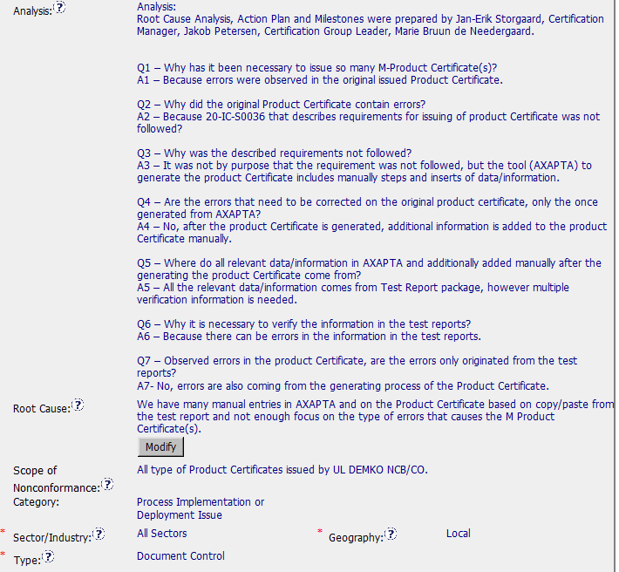
Good CAR (11398960)
Stakeholders involved and named
Thought process clear and complete
Short and linked to the NC
Indicates how widespread and what areas and location have the problem

Slide 45
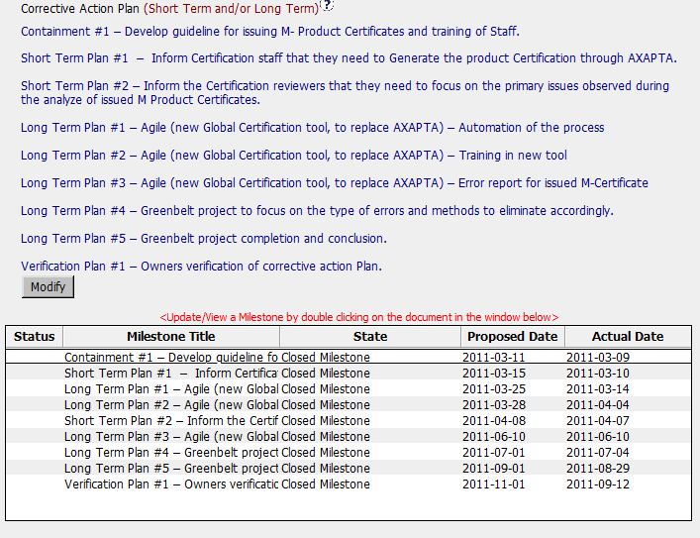
Good CAR (11398960)
Include containment, short and long term actions and verification.
Short term actions address the symptoms and long term address the root cause.
Logical connection between CAP-RC-Requirement
Include actions looking to eliminate the manual entries process (mistake-proof method)
Plan consider the implementation of Agile as a
Milestone due dates are not the same

Slide 46
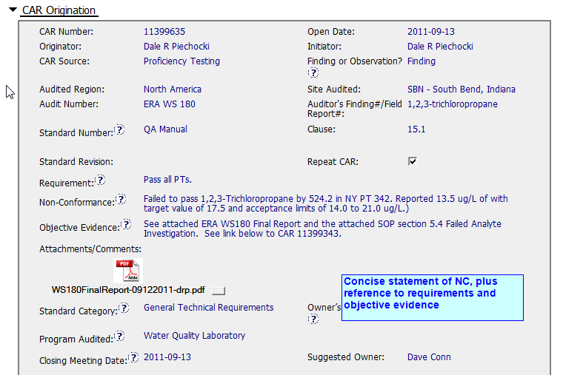
Good CAR (11399635)

Slide 47
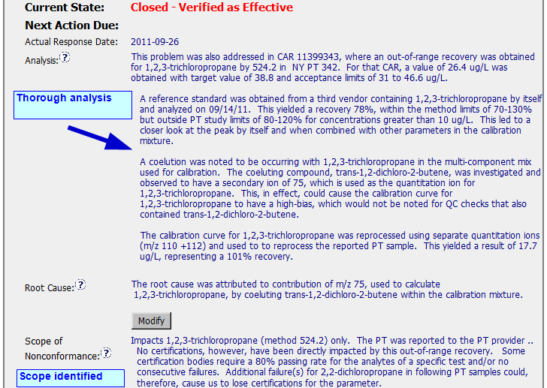
Good CAR (11399635)

Slide 48
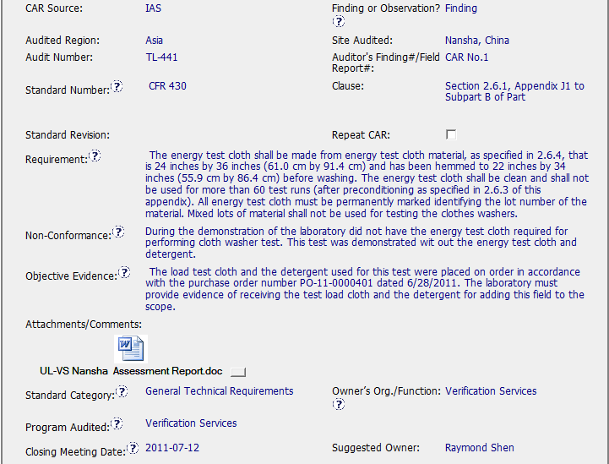
Bad CAR (11399426)
Data of applicable clause is incomplete (430 missed at the end of the field)
Infomation in the Objective Evidence field is part of the CAR written by the Auditor instead of provide the data of the equipment in which the test was performed even when it is available in the document attached.
Notes:
Para DTW y NOVI se debe crear una CAR, y el CAR Owner será quien comunique al cliente la resolución y debe incluir una milestone en la CAR específica para dicha comunicación

Slide 49
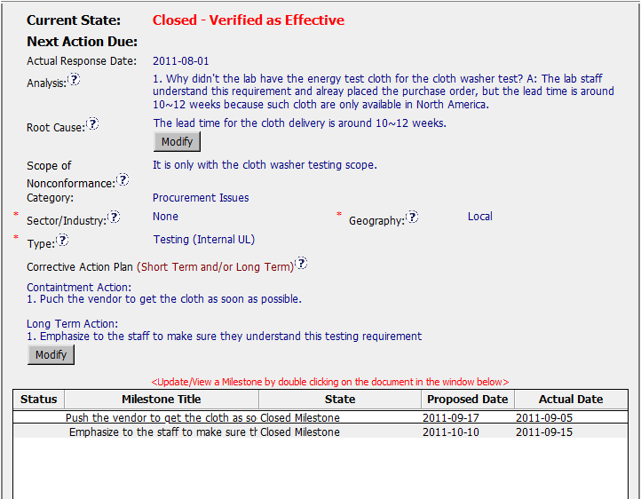
Bad CAR (11399426)
NC is related with the execution of a test without use the required materials but analysis is directed to the reception of the energy test cloth.
What about the detergent?
Why the test was performed even when the materials required to perform it were not available?
NOTE: Auditor CAR directs to work about consumables reception more than evaluate why the test was performed out of specifications.
No action to verify the effectiveness of actions taken.
Notes:
Se copia a Customer Advocacy Mailbox si el cliente es una cuenta asignada en el directorio de productos (NA Only) o el cliente indica que escalará la queja a la alta dirección

Slide 50
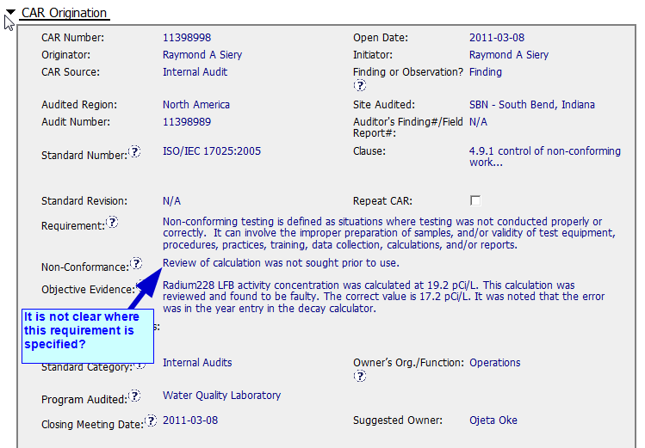
Bad CAR

Slide 51
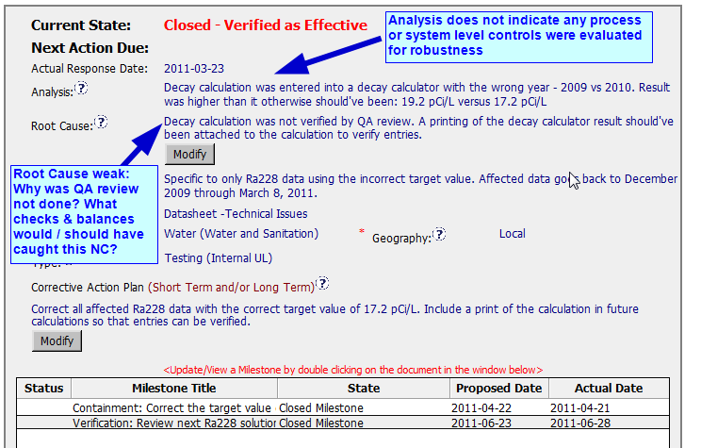
Bad CAR

Slide 52
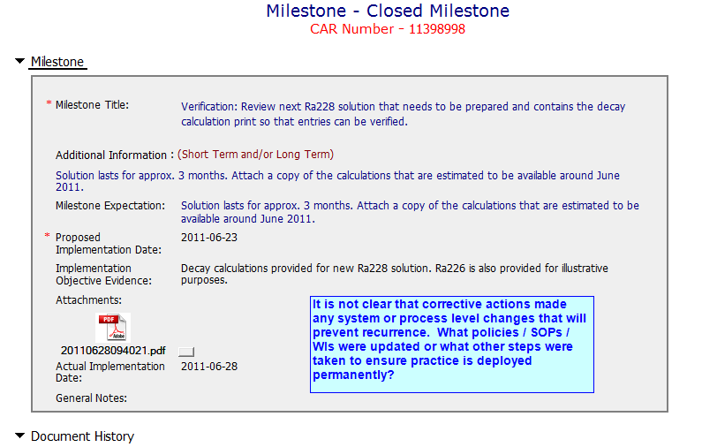
Bad CAR

Slide 54
THANK YOU !

